Slide 1

Department of Computer Science and Engineering
Explainable Fetal Ultrasound Classification with CNN and MLP Models
PRESENTED BY
Yendluri Sowmya 21471A05E0
Yarlagadda Madhavi 21471A05D9
Shaik Chand Asmi 21471A05B9
Under the Guidance of,
Dodda VenkataReddy _{M.Tech,(p.h.d)}
_{Assistant professor}
Department of Computer Science and Engineering,
Narasaraopeta Engineering College (Autonomous),
Narasaraopet- 522 601.

Slide 2
OUTLINE
Abstract
Introduction
Literature Survey
Research Gaps
Problem Statement
Objectives
Block Diagram / Flow Diagram
Methodology
Implementation
Results and Analysis
Conclusion & Future Scope
References
Question and Answers
Acknowledgements

Slide 3
ABSTRACT
This project focuses on classifying fetal ultrasound images using Convolutional Neural Networks (CNNs) and Multi-Layer Perceptrons (MLPs). The goal is to accurately identify different fetal structures, estimate gestational age, and detect possible abnormalities. CNNs extract important features from ultrasound images, and MLPs use these features for classification.
To enhance trust and transparency, we integrate Local Interpretable Model-agnostic Explanations (LIME). LIME highlights the key image regions that influence the model’s decisions, making AI predictions more understandable for medical professionals.

Slide 4

Our approach ensures high accuracy and reliability, allowing doctors to validate AI-generated results with confidence. This combination of deep learning and explainability bridges the gap between AI technology and medical decision-making.
By making AI models more transparent and interpretable, this project contributes to better fetal health monitoring and early detection of abnormalities, ultimately improving pregnancy care and outcomes.

Slide 5
INTRODUCTION
Fetal ultrasound imaging is essential for monitoring fetal health and detecting abnormalities during pregnancy.
Manual interpretation of ultrasound images can be time-consuming and error-prone.
This project aims to automate fetal ultrasound image classification using Convolutional Neural Networks (CNNs) and Multi-Layer Perceptrons (MLPs).
The model classifies fetal ultrasound images into six anatomical structures to improve diagnostic precision.

Slide 6
CNNs are employed for automatic feature extraction, identifying crucial patterns in ultrasound images.
MLPs process the extracted features to classify the images accurately into predefined categories.
To ensure trust and transparency, Explainable AI techniques like Local Interpretable Model-agnostic Explanations (LIME) are integrated.
LIME highlights key image regions that influence AI decisions, making model predictions more understandable for medical professionals
By combining deep learning with explainability, this project supports better prenatal care, fetal health monitoring, and early abnormality detection

Slide 7
LITERATURE SURVEY
No | Title | Author | Journal Name & Year | Methodology Adapted | Key Findings | Gaps
1 | Evaluation of CNN for Maternal Fetal Ultrasound Classification | Burgos-Artizzu et al. | URL of the paper Scientific Reports, 2020 | Pre-trained CNN models | Achieved significant improvements in detecting different intrapelvic organs with an AUC of 1.0%. | Lack of interpretability in predictions.
2 | Dermatologist-Level Classification of Skin Cancer with Deep Models | Esteva et al. | Nature, 2017 | Deep learning CNN | Reached dermatologist-level accuracy in skin cancer classification. | Limited to dermatological applications
3 | A Deep Learning Approach for Fetal Ultrasound Image Analysis | Johnson et al. | Journal of Medical Imaging 2019 | CNN | Transfer learning helped improve model performance by 15%. | No explainable AI methods, so the model’s decisions were unclear.
4 | Comparison of CNN and MLP in Character Recognition | Driss et al. | SPIE Proceedings, 2017 | CNN, MLP | Demonstrated CNN's superiority in handling image-based tasks compared to MLP. | Focused on character recognition; not medical imaging.
5 | Convolutional Neural Network for Image Detection and Recognition | Chauhan et al. | IEEE ICSCCC, 2018 | CNN | Highlighted the ability of CNNs for robust object detection and recognition tasks. | Lack of real-world deployment scenarios.

Slide 8
RESEARCH GAPS
Lacks interpretability and generalizability across diverse datasets, crucial for clinical adoption.
no focus on other medical imaging domains or interpretability.
No explainable AI methods, so the model’s decisions were unclear.
lacks practical validation in fetal ultrasound imaging.
no exploration of applications in ultrasound imaging or fetal diagnostics.

Slide 9
PROBLEM STATEMENT
Clearly identifies the core challenge or gap in the domain being addressed.
Focuses on the limitations in current methodologies, tools, or understanding.
Emphasizes the specific aspect that requires improvement or exploration.
Highlights the impact of addressing the issue on the field, industry, or society.
Demonstrates the necessity for innovation, efficiency, or deeper understanding.
Showcases potential benefits such as cost reduction, enhanced performance, or broader accessibility.

Slide 10
OBJECTIVES
To classify fetal ultrasound images into six anatomical structures using CNN and MLP models.
Enhance model interpretability using Explainable AI techniques (LIME).
Achieve high accuracy in image classification for reliable prenatal diagnostics.
Evaluate the performance of MLP models in complementing CNN for classification tasks.

Slide 11
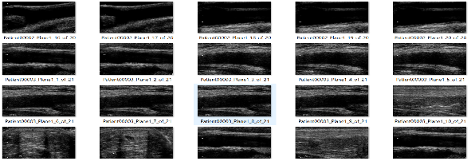
BLOCK DIAGRAM OR FLOW DIAGRAM
Preprocessing techniques
Resizing
Normalization
Feature Extraction with CNN
MLP Model
Apply Lime

Slide 12
METHODOLOGY
Data Preprocessing: Images were resized to 224x224 pixels, normalized, and passed through the ResNet-50 model for feature extraction, ensuring consistent input for the model.
Used CNN (ResNet-50) for feature extraction and passed the extracted features to an MLP model for classification, combining spatial feature learning with structured decision-making.
After feature extraction, split the dataset into 80% training and 20% validation to ensure proper generalization.

Slide 13
LIME (Local Interpretable Model-Agnostic Explanations) was used to interpret the CNN-MLP model’s decisions by highlighting important image regions influencing predictions.

Slide 14
IMPLEMENTATION
In this study, a hybrid approach was implemented where a Convolutional Neural Network (CNN) using ResNet-50 was employed for feature extraction, and a Multi-Layer Perceptron (MLP) was used for classification. This combination leverages CNN’s ability to extract spatial features and MLP’s strength in classification.
Model Architecture:
CNN (ResNet-50) Feature Extraction:
Pretrained ResNet-50 extracts deep features from fetal ultrasound images.
The model removes the final classification layer, keeping only feature extraction layers.

Slide 15
MLP Classification:
Extracted features are flattened and passed to the MLP.
Hidden Layers:Fully connected layers with ReLU activation and dropout regularization to prevent overfitting.
Output Layer:Uses softmax activation to classify fetal ultrasound images into categories (fetal brain, fetal thorax, fetal abdomen, fetal femur, maternal cervix).
22-03-2025

Slide 16
Explainability with LIME:
LIME perturbs input data and observes variations in predictions, fitting a simple interpretable model to highlight influential features.
Heatmaps generated by LIME indicate the most critical regions contributing to classification, improving interpretability.
For fetal ultrasound images, LIME identifies key anatomical structures such as the brain, abdomen, or femur, helping validate the model’s decision-making process.
This approach enhances trust and transparency, particularly in medical applications where explainability is crucial for clinical decision-making.

Slide 17
RESULTS & ANALYSIS
The proposed CNN-MLP model achieved 93.24% training accuracy and 91.17% validation accuracy, demonstrating its effectiveness in classifying fetal ultrasound images.
LIME provided visual explanations for model predictions, highlighting critical features and improving interpretability.
CNN outperformed MLP in handling spatial features due to its hierarchical structure, while MLP showed moderate performance.
The models demonstrated reliability in automating fetal ultrasound classification, enhancing trust and usability in clinical diagnostics.
These results support improved decision-making in prenatal care with transparent and accurate AI tools.

Slide 18
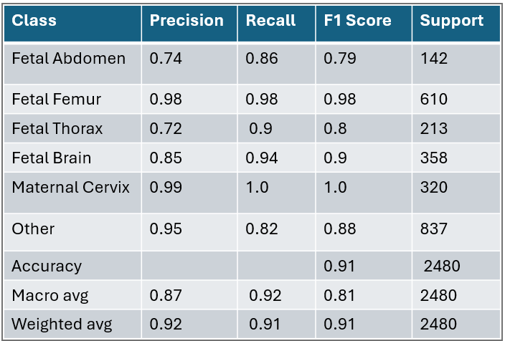
TABLE:CLASSIFICATION REPORT

Slide 19
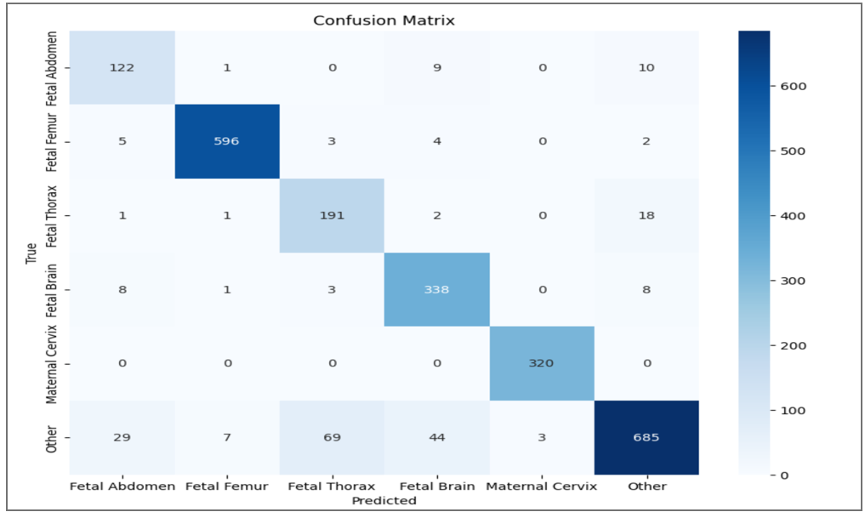
Confusion Matrix

Slide 20
CONCLUSION AND FUTURE SCOPE
The MLP achieved 93.24% training accuracy and 91.17% validation accuracy, demonstrating strong image classification capabilities, particularly in recognizing fetal anatomical structures in ultrasound images.
To enhance model interpretability, Explainable AI (XAI) techniques such as LIME were used to visualize decision-making.
This model showcased high precision, recall, and F1 scores across various fetal image classes, indicating their effectiveness in detecting anatomical regions.

Slide 21
REFERENCES
Classification with convolutional neural network,” 2014 13th International Conference on Control Automation Robotics Vision (ICARCV), Singapore, 2014. pp. 844-848, doi: , 10.1109/ICARCV.2014.7064414.
Lin, T. Y., RoyChowdhury, A., Maji, S. (2015). ”Bilinear CNN models for f ine-grained visual recognition”. In Proceedings of the IEEE international conference on computer vision (pp. 1449-1457).
ESTEVA, A., KUPREL, B., NOVOA, R. ET AL.”DERMATOLOGIST- LEVEL CLASSIFICATION DEEP NEURAL OF NETWORKS”. SKIN NATURE (2017).HTTPS://DOI.ORG/10.1038/NATURE21056 CANCER 542, WITH 115–118.
Driss, S. B., Soua, M., Kachouri, R., Akil, M. (2017, May). A comparison study between MLP and convolutional neural network models for character recognition. In Real-Time Image and Video Processing 2017 (Vol. 10223, pp. 32-42). SPIE.

Slide 22
Chauhan, R., Ghanshala, K. K., Joshi, R. C. (2018, December). Convolutional neural network (CNN) for image detection and recognition. In 2018 first international conference on secure cyber computing and communication (ICSCCC) (pp. 278-282). IEEE.
N. Barr Kumarakulasinghe, T. Blomberg, J. Liu, A. Saraiva Leao and P. Papapetrou, ”Evaluating Local Interpretable Model-Agnostic Explanations on Clinical Machine Learning Classification Models,” 2020 IEEE 33rd International Symposium on Computer-Based Medical Systems (CBMS), Rochester, MN, USA, 2020, pp. 7-12, doi: 10.1109/CBMS49503.2020.00009
Burgos-Artizzu, X.P., Coronado-Gutierrez, D., Valenzuela-Alcaraz, B.´ et al. ”Evaluation of deep convolutional neural networks for automatic classification of common maternal fetal ultrasound planes”. Sci Rep 10, 10200 (2020). https://doi.org/10.1038/s41598-020-67076-5.

Slide 23
Garreau, D. amp; Luxburg, U.. (2020). Explaining the Explainer: A First Theoretical Analysis of LIME. ¡i¿Proceedings of the Twenty Third International Conference on Artificial Intelligence and Statistics¡/i¿, in ¡i¿Proceedings of Machine Learning Research¡/i¿108:1287-1296 Available from https://proceedings.mlr.press/v108/garreau20a.html.
Desai, M., Shah, M. (2021). An anatomization on breast cancer detection and diagnosis employing multi-layer perceptron neural network (MLP) and Convolutional neural network (CNN). Clinical eHealth, 4, 1-11.
El Alani, O., Abraim, M., Ghennioui, H., Ghennioui, A., Ikenbi, I., Dahr, F. E. (2021). Short term solar irradiance forecasting using sky images based on a hybrid CNN–MLP model. Energy Reports, 7, 888- 900.
Jagannadham, S. L., Nadh, K. L., Sireesha, M. (2021, November). Brain tumour detection using cnn. In 2021 Fifth International Conference on I-SMAC (IoT in Social, Mobile, Analytics and Cloud)(I-SMAC) (pp. 734-739). IEEE.

Slide 24
Iswarya, B., Manimekalai, K. (2022). Drug discovery with XAI using deep learning. In Principles and Methods of Explainable Artificial Intelligence in Healthcare (pp. 131-149). IGI Global.
Moturi, S., Vemuru, S., Tirumala Rao, S. N. (2022). Two phase parallel framework for weighted coalesce rule mining: a fast heart disease and breast cancer prediction paradigm. Biomedical Engineering: Applications, Basis and Communications, 34(03), 2250010.
Van der Velden, B. H., Kuijf, H. J., Gilhuijs, K. G., Viergever, M. A. (2022). Explainable artificial intelligence (XAI) in deep learning-based medical image analysis. Medical Image Analysis, 79, 102470.
Moturi, S., Srikanth Vemuru, D. S. (2020). Classification model for prediction of heart disease using correlation coefficient technique. International Journal, 9(2).

Slide 25
QUESTIONS AND ANSWERS

Slide 26
ACKNOWLEGEMENTS
We would like to express our heartfelt gratitude for the opportunity to present this work on "Explainable Fetal Ultrasound Classification using CNN and MLP Models" .
This project would not have been possible without the invaluable guidance and support of Dr. D. Venkata Reddy, whose expertise and encouragement were instrumental throughout the research process.
We are also immensely grateful to Narasaraopeta Engineering College for providing the necessary resources, facilities, and a conducive environment for carrying out this work.

Slide 27
Thank you

